Slide 1





“A New Era for Digital Streaming in India"
Rajdeep Kumar
Data Analyst
Main Goal:
Analysis performance and user behavior of both platforms

Slide 2
Agenda
1. Total Users & Growth Trends
2. Content Library
3. User By Demographics
4. User By Activeness
5. Correlation of Inactiveness
6. User Downgrade Trends
7. User Upgraded Trends
8. Paid Users Distribution
9. Revenue Trends
10. Executive Summary
11. Recommendation

Slide 3
Total Users & Growth Trends

Slide 4
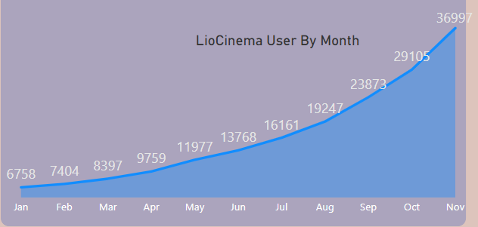
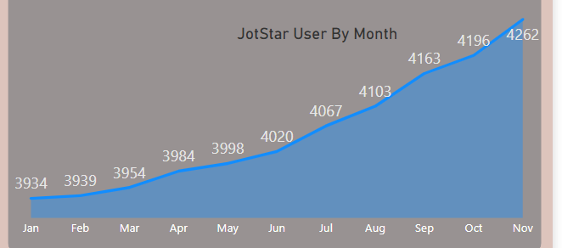
Total Users 183K
Total Users 45K
LioCinema total users = 4 * JotStar total users
Growth Rate 23.3%
Growth Rate 10.6%
LioCinema Gowth rate = 2 * JotStar Gowth Rate

Slide 5
User By
Content Library

Slide 6
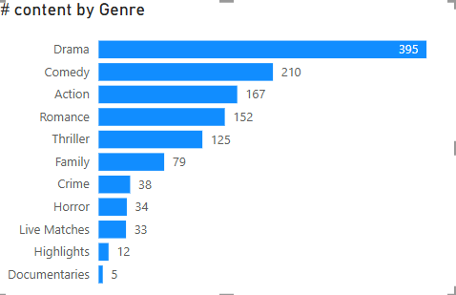
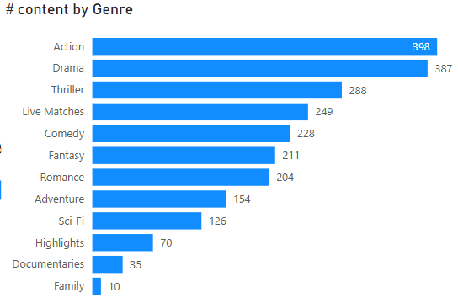


Total Content: 1250
Runtime(min):
129K
Total Content: 2360
Runtime(min):
221K
Strengths
Strengths
Observation: JotStar has almost double the content volume and total runtime.
Key Insight: JotStar has a wider genre variety, including Fantasy, Adventure, and Sci-Fi, which are less prominent in LioCinema.

Slide 7
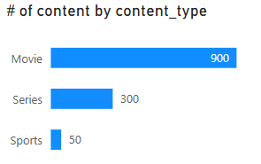
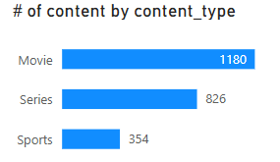
Total Content: 1250
Runtime(min):
129K
Total Content: 2360
Runtime(min):
221K
More focus
Less Focus
Diverse
Key Insight: JotStar is more diverse in series and sports, while LioCinema is heavily movie-focused.

Slide 8
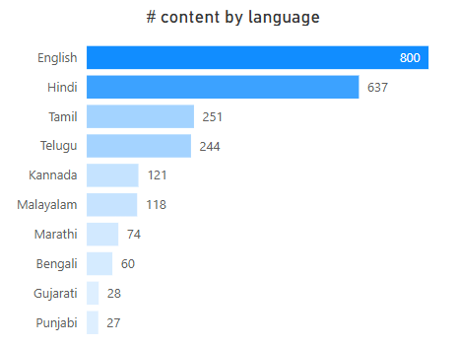
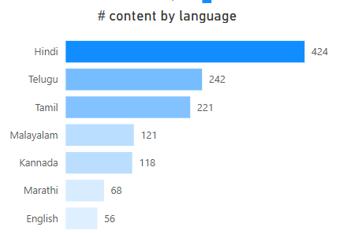

Total Content: 1250
Runtime(min):
129K
Total Content: 2360
Runtime(min):
221K
Strengths
Strengths
Key Insight: JotStar has a strong English and regional presence, while LioCinema is more Hindi-centric.

Slide 9
Key Insights from Content Library Comparison
Overall Content & Runtime
JotStar has almost double the content volume and total runtime compared to LioCinema.
Genre Diversity
LioCinema is stronger in Drama, Comedy, and Action.
JotStar has a wider variety with more Thrillers, Live Matches, Fantasy, and Adventure content.
Content Type Mix
LioCinema is movie-dominated, while JotStar has a stronger balance of movies, series, and sports.
Language Representation
LioCinema is Hindi-centric, while JotStar has a broader English and regional content presence.

Slide 10
User By Demographics
User by Age Group
Users by city tiers
Users by subscription Plan

Slide 11
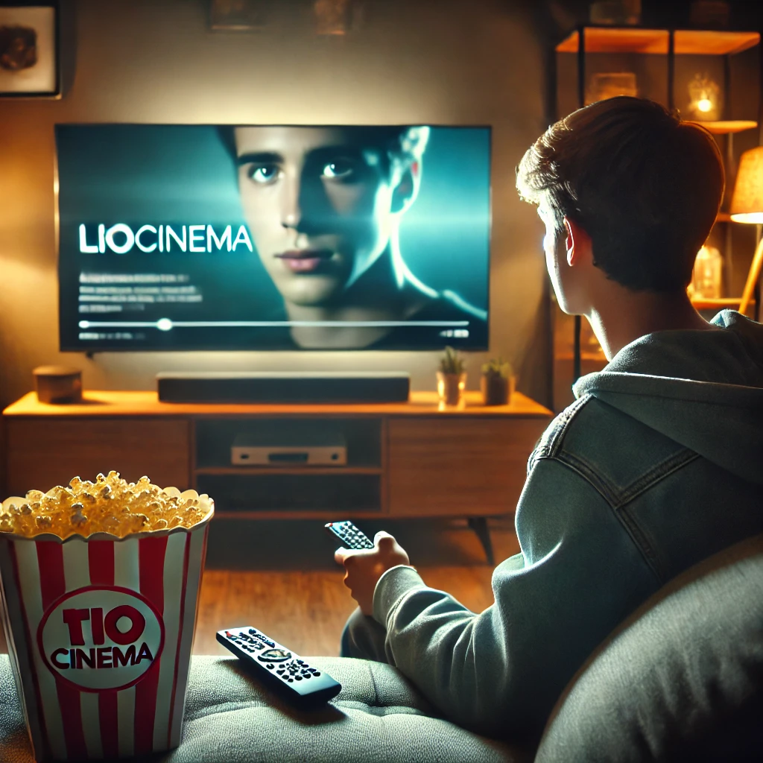
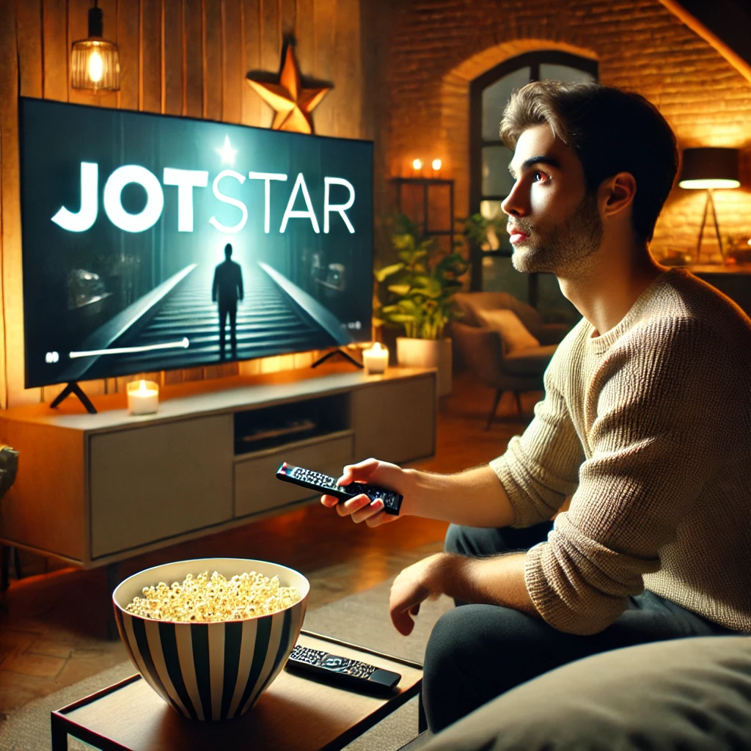
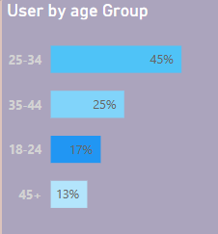
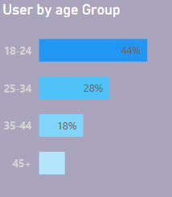
Young adults and Middle age
Young
Insight: LioCinema is more popular among younger audiences compared to JotStar, which had a stronger 25-34 segment i.e. Middle age adults Or working professional

Slide 12
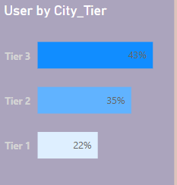
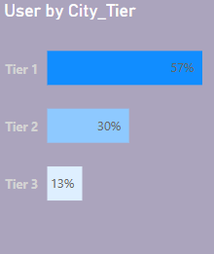
Around 80% from Tier 3 and 2
Around 90% from Tier 1 and 2
For 6 out of 10 user are from Tier-1 city and 3 are from Tier 2 city.
Insights:
LioCinema has a stronger presence in smaller cities unlike
JotStar has a strong urban presence but weaker penetration in smaller cities.

Slide 13
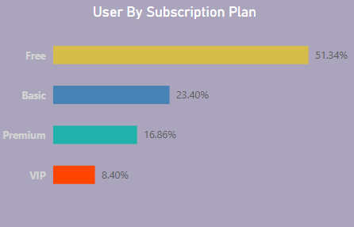
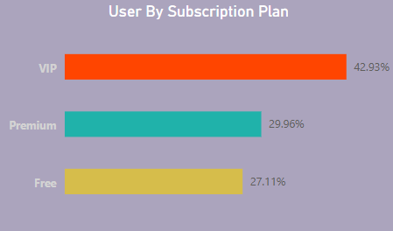
73% users are Paid users
Each 1 out of 2 users are Free users.
Each 3 out of 4 user are paid user.
Insights:
LioCinema Monetization through subscriptions is weaker compared to JotStar
JotStar Users are willing to pay for premium content, indicating strong monetization potential.

Slide 14
Key Insights from User Demographics Comparison
JotStar appeals to a more mature audience or Working Professional , while LioCinema is youth-focused.
JotStar is urban-focused, while LioCinema dominates smaller towns.
JotStar has a more balanced monetization strategy, while LioCinema is highly dependent on ads.

Slide 15
User By Activeness

Slide 16
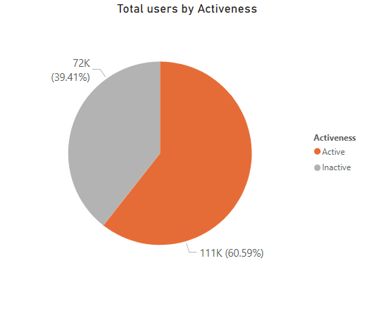
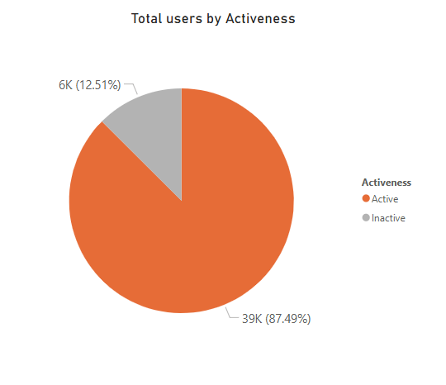

Slide 17
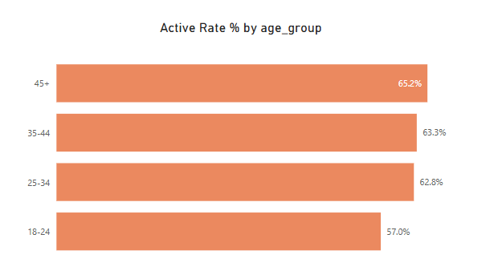
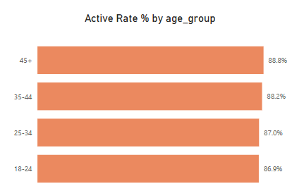
The Active rate increase with age.
Users aged 45+ have the highest active rate at 65.2%.
Younger users (18-24) have the lowest active rate
JotStar has a higher active rate across all age groups.
45+ age group has the highest activity (88.8%).
Younger users (18-24) have the lowest active rate

Slide 18
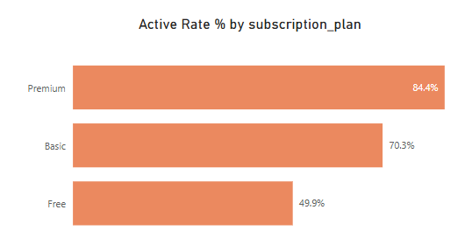
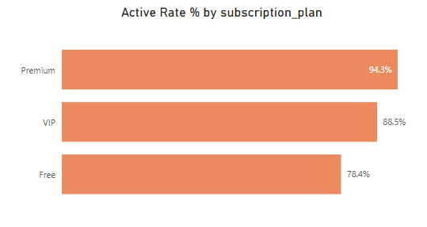
Premium users have the highest engagement (84.4%)
Free users have significantly lower engagement.
Premium users are the most engaged (94.3%), followed by VIP users (88.5%).
Unlike LioCinema, JotStar has a much higher engagement rate for Free users (78.4% vs. 49.9%).

Slide 19
Correlation of Inactiveness

Slide 20
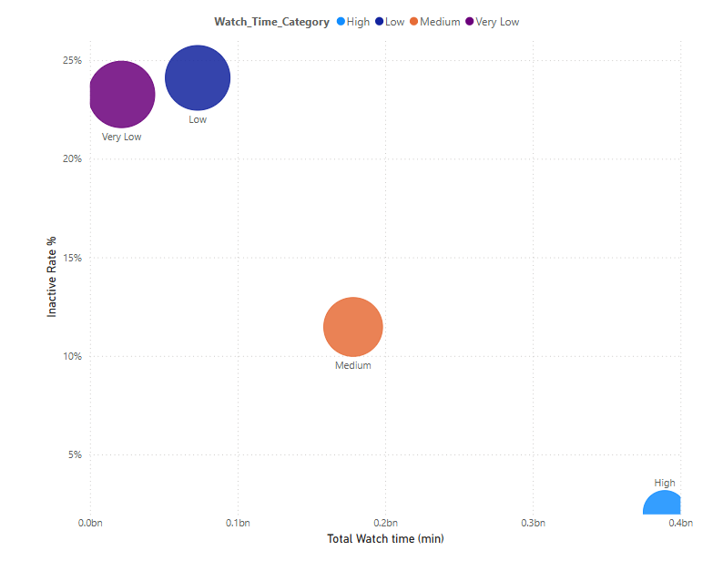
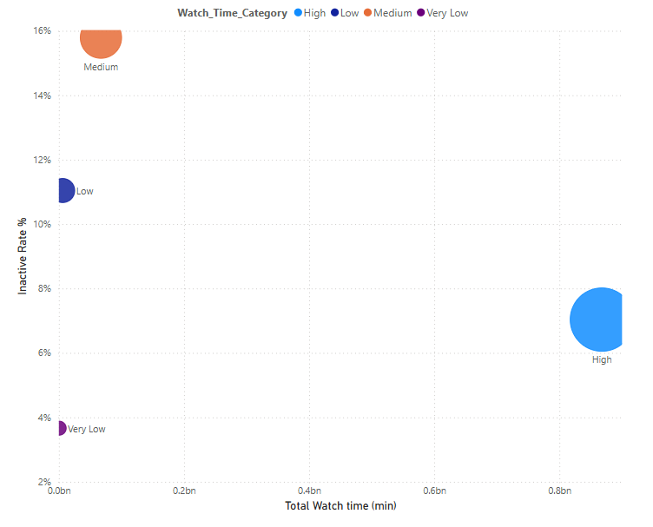

In LioCinema With High Watch time
Low inactive Rate
In JotStar With High Watch time
Low inactive Rate
Medium Watch Time
High inactive Rate
Low Watch Time
High inactive Rate
Very Low Watch time
Low inactive Rate

Slide 21
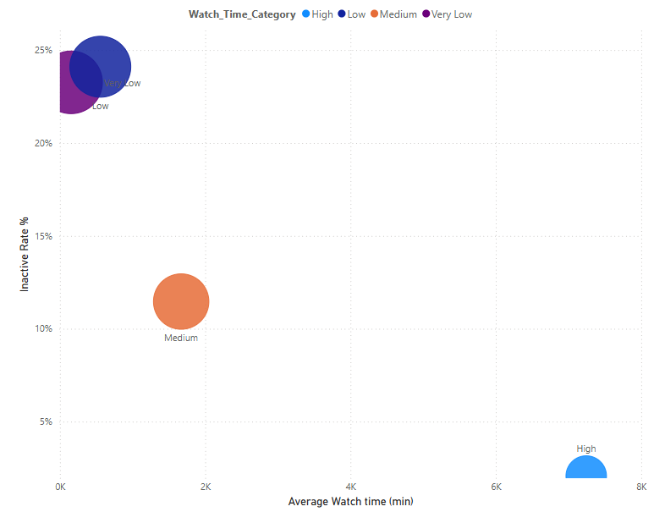
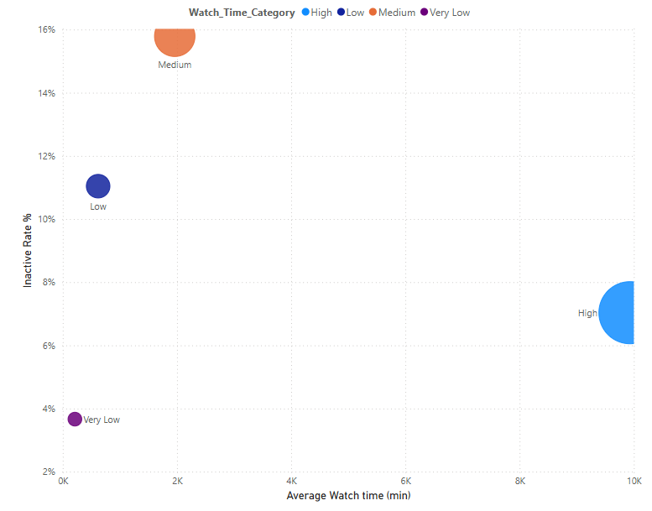
Similar to previous
In LioCinema With High Watch time
Low inactive Rate
In JotStar With High Watch time
Low inactive Rate
Low Watch Time
High inactive Rate
Medium Watch Time
High inactive Rate
Very Low Watch time
Low inactive Rate

Slide 22
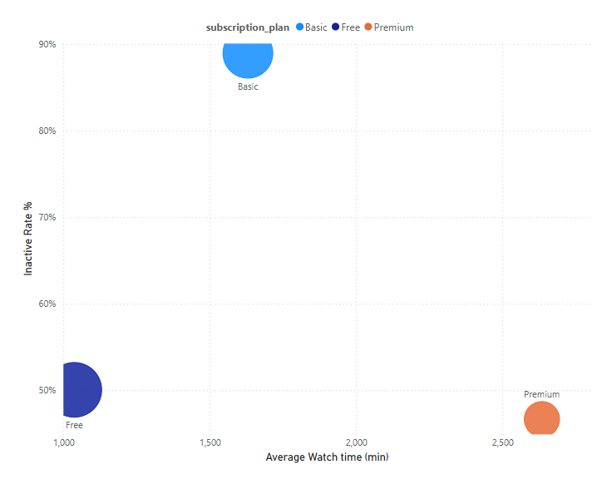
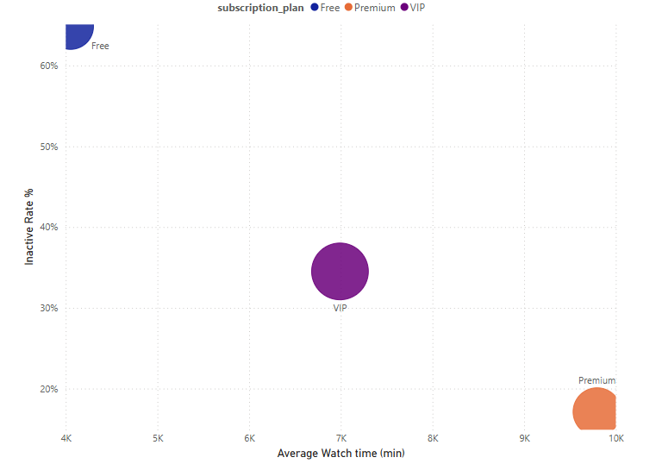
Basic
Very high inactivity rates
Free
Very high inactivity rates
Free
50% inactive with lowest avg watching
VIP
30 % inactivity with high avg watch time.
Premium
Low inactive and high avg watch time
Premium
Low inactive and very high avg watch time

Slide 23
User Downgrade Trends

Slide 24
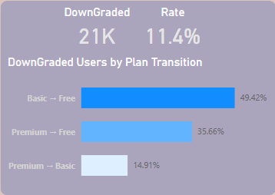
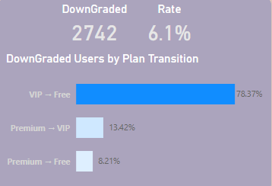
LioCinema = 2 × JotStar
78.37% VIP to Free (suggests that VIP perks might not justify the cost for many).
13.42% Premium to VIP (indicating a cost-conscious downgrade while still staying within paid plans).
8.21% Premium to Free, which is significantly lower than LioCinema’s 35.66% downgrade from Premium to Free.
49.42% Basic to Free (suggesting that many users are unwilling to continue paying).
35.66% Premium to Free (indicating dissatisfaction with premium benefits).
14.91% Premium to Basic (some cost-conscious users still willing to pay but at a lower tier).

Slide 25
User Upgraded Trends

Slide 26
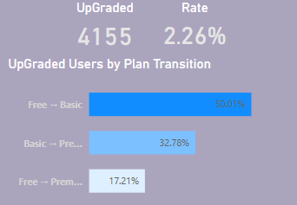
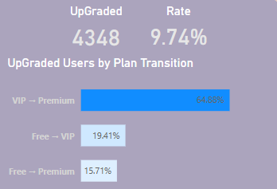
JotStar = 5 × LioCinema
Most Common Upgrade: Free → Basic (50.01%)
Most Common Upgrade: VIP → Premium (64.68%)
JotStar users have a strong preference for upgrading from VIP to Premium, suggesting a well-performing intermediate VIP plan that encourages further upgrades.
LioCinema users are more likely to upgrade from Free to Basic first rather than jumping directly to Premium.

Slide 27
Paid Users Distribution

Slide 28
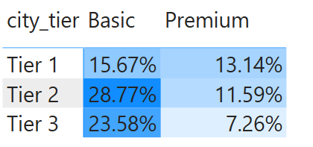
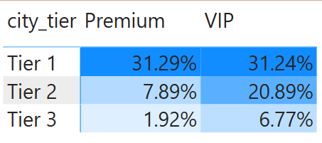
Basic Plan
mid-tier (Tier 2) cities
Premium
Urban-tier (Tier 1) cities
Strong
Appeal
Strong
Appeal
JotStar's Premium plan is mostly attracting users from major urban centers.
Premium
Urban-tier (Tier 1) cities
Strong
Appeal
VIP
Urban-tier (Tier 1) cities
Strong
Appeal
But showing more significant presence in Tier 2 and Tier 3 compared to premium plan
less popular in lower-tier cities, possibly due to cost sensitivity.
VIP plan might include features or pricing that attract a wider geographic audience.

Slide 29
Revenue Trends

Slide 30
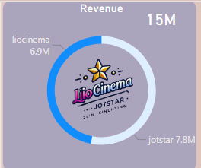
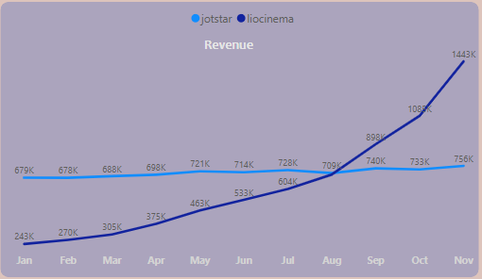
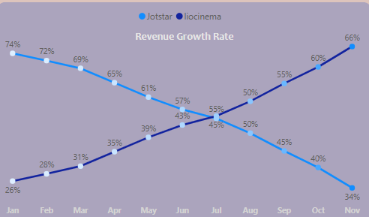
Total Revenue
JotStar Revenue is Similar
LioCinema Revenue is Growing rapidly.
JotStar Revenue Rate is going down
LioCinema Revenue Growth Rate is going up rapidly

Slide 31
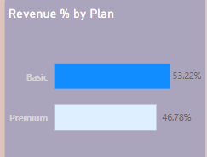
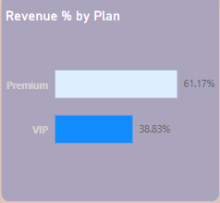
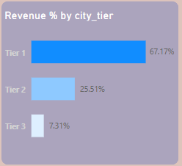
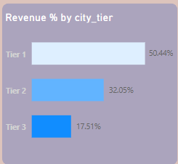
Majority of revenue than the Premium plan
Slightly more revenue than the Premium plan
Large portion of revenue comes from Basic plan
Potentially price sensitive customer base
Revenue model relies heavily on its premium plan
Primarily an urban-focused platform
LioCinema’s primary revenue source is urban centres (Tier 1)
nearly 2/3rd of its revenue coming from Tier 1 cities
Due to higher purchasing power and a larger user base in these areas

Slide 32
Key Insights from Revenue Trends
JotStar is more dependent on urban markets, while LioCinema has a more diversified revenue stream across city tiers.
LioCinema’s revenue from the Basic plan (53.22%) indicates a strong appeal to a cost-conscious audience, likely contributing to its broader reach into Tier 2 and Tier 3 cities.
JotStar’s revenue from the Premium plan (61.17%) and a significant contribution from the VIP plan (38.83%) suggest a focus on higher-income users who are willing to pay for premium or exclusive services. This aligns with JotStar’s urban focus.

Slide 33
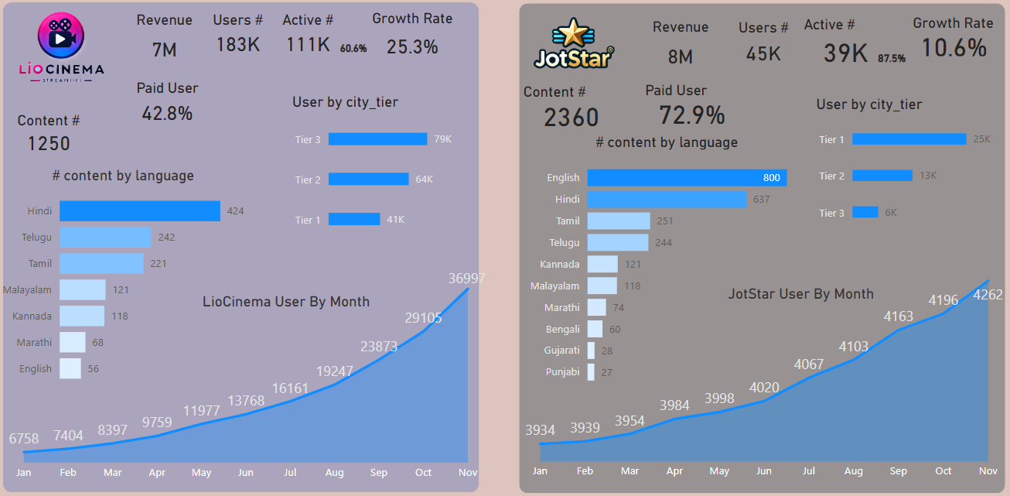


Executive Summary
LioCinema: High Reach, Low Monetization
JotStar: Premium Model, Slow Growth
183K users but only 42.8 % are paid ➡️ $7M revenue
45K users but 72.9 % are paid ➡️ $8M revenue
⬆️ Fastest growth (25.3%), mainly in Tier 2 & 3 cities
➡️ Slow growth (10.6%), strongest in Tier 1 cities
Content Dominance: Hindi & regional languages
Content Dominance: English & Hindi

Slide 34
Strategies & Recommendations for Merged OTT Platform (LioCinema-JotStar)

Slide 35
To Increase Engagement
Recommendation
Analysis
Use AI to suggest relevant content based on past preferences
Personalized Recommendations
Gamification
Personalized Notifications
Freemium Teasers
Interactive Features
- Targeted Content for Youth
LioCinema: Struggles with engagement in Free and Basic tiers, with a significant portion of users showing low watch time (e.g., 49.9% engagement rate for Free users vs. JotStar’s 78.4%).
Younger users (18-24) have the lowest active rates, while older users (45+) are more engaged (65.2%).
JotStar: Demonstrates higher overall engagement, even among Free users (78.4%), and retains high-value customers (Premium: 94.3%, VIP: 88.5%).
Introduce badges, streaks, and rewards for watching and engaging.
Offer limited-time access to Premium content for Free users (e.g., a “Premium Weekend”) to showcase value and encourage upgrades, leveraging JotStar’s success with paid-tier engagement.
Add polls, quizzes, or live watch parties (e.g., for sports or popular series) to boost community engagement, appealing to JotStar’s diverse content strengths.
Develop short-form, trendy content (e.g., web shorts, reels) to attract and retain LioCinema’s inactive 18-24 age group, aligning with their consumption habits.

Slide 36
Brand Campaigns to Establish Market Leadership
Analysis
Recommendation
LioCinema: Youth-focused, Hindi-centric, and dominant in Tier 2 and 3 cities with a movie-heavy library.
JotStar: Appeals to mature, urban audiences (Tier 1) with a balanced mix of movies, series, and sports, and
Emphasize unified access to JotStar’s premium English/Hindi content and LioCinema’s regional library.
“One Platform, Every Story” Campaign
Urban-Rural Connect
Social Media Engagement
Festive Campaigns
User-Generated Content
Live & Interactive Features:
Launch dual campaigns—urban-focused ads showcasing premium features (e.g., ad-free, VIP perks)
rural-focused ads emphasizing affordability and regional content, blending JotStar’s and LioCinema’s strengths.
Key Insight: The merged platform can position itself as a versatile, all-inclusive OTT service bridging urban and rural India, leveraging JotStar’s premium appeal and LioCinema’s mass-market reach.
Collab influencers on Instagram, YouTube, and X (Twitter).
Make ads on trendy on Social media site.
Encourage users to share reviews and experiences.
Host live Q&A sessions with actors, behind-the-scenes content, or fan contests.
Tie promotions to Indian festivals (e.g., Diwali, IPL season) with exclusive releases or discounts, capitalizing on JotStar’s sports offerings and LioCinema’s movie dominance.

Slide 37
Subscription Pricing Strategy
Recommendations:
Analysis
LioCinema:
57% Free users, weak monetization (2.26% upgrade rate),
high downgrades (e.g., 35.66% Premium to Free).
Revenue split: Basic (53.22%), Premium (46.78%)
JotStar:
Strong paid user base (72.8%),
high upgrade rate (9.74%)
significant VIP-to-Free churn (78.37%)
Revenue split: Premium (61.17%), VIP (38.83%).
Key Insight: JotStar’s premium users drive revenue, while LioCinema’s Free tier reliance limits profitability. A tiered, flexible pricing model can balance reach and revenue.
Ad-supported with basic access (movies, select series) to retain LioCinema’s Tier 3 base.
Freemium Model
Basic Tier (~₹59/month)
Premium Tier (~₹159/month)
VIP Tier (~₹259/month)
Annual Plans with Discounts:
Micro-Subscriptions:
Dynamic Pricing
Regional Discounts
Ad-light, includes regional content and select sports, targeting Tier 2 upgrades from LioCinema’s Basic users.
Ad-free, full library access (movies, series, sports), appealing to JotStar’s urban Premium users.
Exclusive perks (early releases, offline downloads, 4K streaming), refined to reduce JotStar’s VIP churn.
Offer 20-30% off annual subscriptions (e.g., Premium at ₹1599/year) to lock in users and improve retention.
Introduce weekly plans (e.g., ₹15/week) for Tier 3 users, encouraging LioCinema’s Free users to test paid tiers affordably.
Use AI to offer personalized discounts to at-risk users (e.g., those likely to downgrade), balancing profitability with retention.
Offer Basic at ₹39/month in Tier 3 cities.

Slide 38
Telecom Partnerships for Subscriber Growth
Analysis
LioCinema: Strong in Tier 2 and 3 cities (80% users), where telecom penetration is high but premium adoption is low
JotStar: Urban-focused (90% from Tier 1 and 2), with a mature audience likely using premium telecom plans.
Key Insight: Telecom partnerships can boost reach in smaller cities (LioCinema’s strength) and bundle premium offerings for urban users (JotStar’s base).
Recommendations:
- Data-Subscription Bundles:
Prepaid Recharge Integration
Zero Data Plan
Offline Access
Co-Branded Promotions:
Referral Incentives:
Partner with Airtel/Jio to offer free Basic plans with 1GB/day data packs.
Allow users to activate subscriptions via prepaid mobile recharges (e.g., ₹249 recharge = 1 month Basic
Introduce zero-rated streaming where users don’t get charged for data while watching.
Enable download-and-watch features for users in low-connectivity areas (Tier 3).
Launch joint campaigns (e.g.,
“Jio Presents LioCinema-JotStar”
) with exclusive content drops or discounts for telecom subscribers.
Offer telecom users bonus data or subscription discounts for referring new subscribers, amplifying growth in both urban and rural markets.

Slide 39
AI/ML for Personalization & Engagement
Recommendations:
Analysis
LioCinema:
Movie-dominated, Hindi-centric, with lower engagement in Free tiers,
suggesting poor content discovery for diverse preferences.
JotStar:
Diverse library (series, sports, thrillers), higher engagement,
indicating potential for personalized recommendations to further boost retention.
Key Insight: AI/ML can bridge LioCinema’s engagement gap and enhance JotStar’s strengths by tailoring experiences across demographics.
Use AI to analyze watch history, demographics (age, city tier), and preferences to suggest content (e.g., Hindi movies for Tier 3, sports for Tier 1), reducing inactivity.
Recommendation Engine
Dynamic Homepages
Predictive Churn Analysis
Sentiment Analysis
Voice Search Integration
Implement ML-driven layouts that adapt to user behavior (e.g., prioritizing series for JotStar’s mature audience, movies for LioCinema’s youth).
Leverage ML to identify at-risk users (e.g., low watch time, downgrade trends) and offer tailored promotions (e.g., free Premium trials) to retain them.
Monitor social media and reviews to prioritize content gaps (e.g., more Tamil thrillers, Hindi family dramas).
Add ML-powered voice recognition in multiple Indian languages (Hindi, Tamil, etc.) to enhance accessibility, especially for LioCinema’s rural users.

Slide 40
Brand Ambassador for the Merged OTT Platform (LioCinema-JotStar)
Analysis
LioCinema: Youth-focused, Hindi-centric, Tier 2/3 dominance—needs a relatable, mass-appeal figure.
JotStar: Mature, urban, diverse content—requires someone with sophistication and broad recognition
Key Insight: The ambassador must bridge urban-rural divides, appeal to both youth and working professionals, and reflect the platform’s inclusive, premium identity.
A Bollywood superstar like Shah Rukh Khan or Vicky Kaushal for national presence.
Pan-India Appeal :
Regional Reach:
Youth Connect:
Have regional icons like Allu Arjun (South), Pankaj Tripathi (Hindi Belt) and Yash (Kannada).
Someone like Virat Kohli or a top influencer to engage Gen Z and millennials.

Slide 41
Conclusion
The merged LioCinema-JotStar platform can dominate India’s OTT market
combining JotStar’s premium, urban strengths with LioCinema’s mass-market, rural reach.
Implementing engagement strategies for inactive users, launching inclusive brand campaigns, optimizing pricing, leveraging telecom partnerships, using AI for personalization, and selecting a versatile ambassador like Sharukh khan will position it as the go-to platform while maximizing profitability and growth.

Slide 42



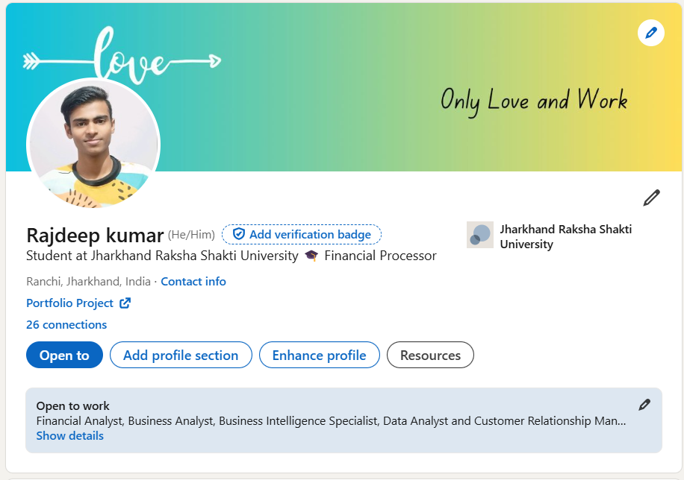

Dashboard
Download Presentation

Slide 43
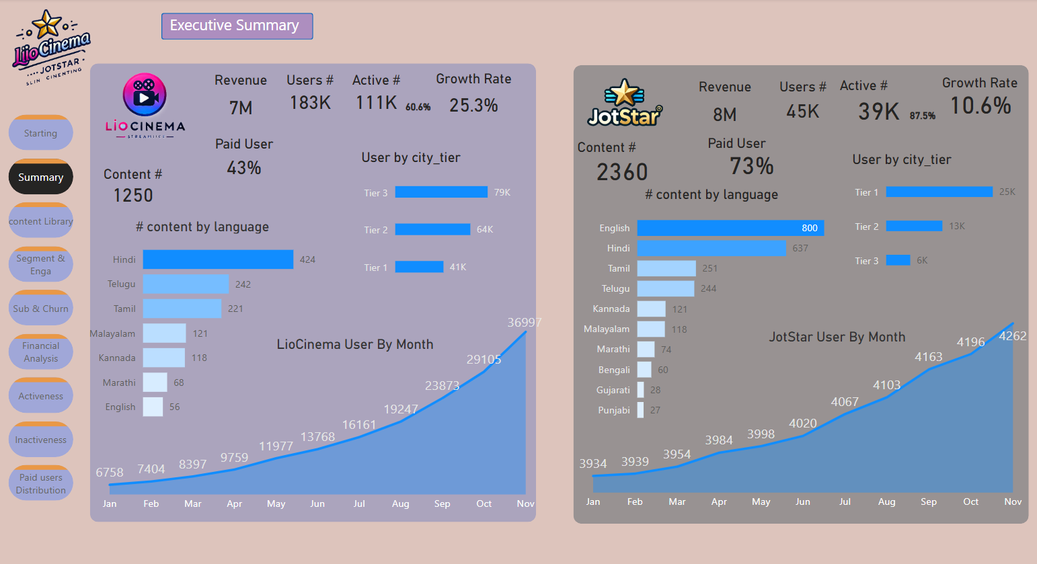
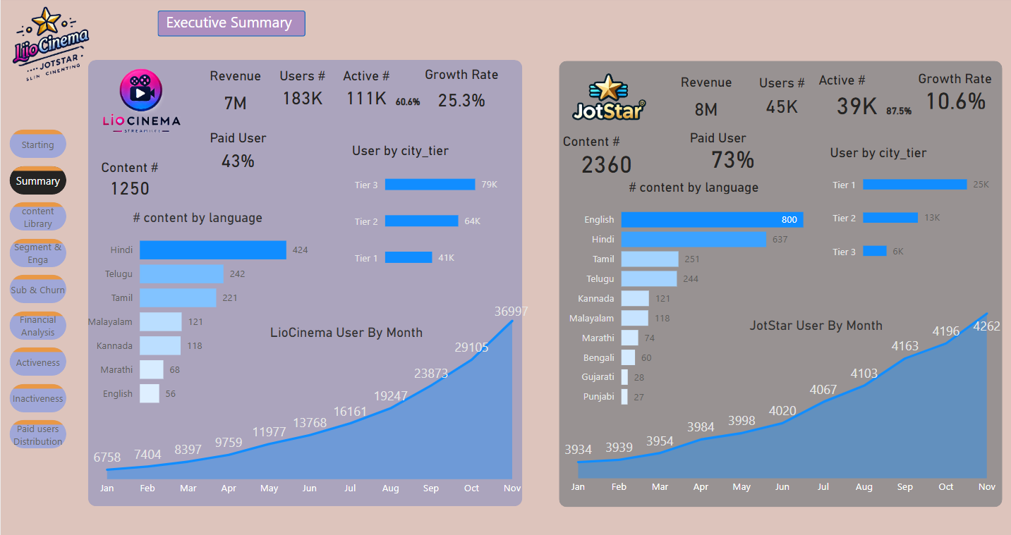
Dashboardd

Slide 44
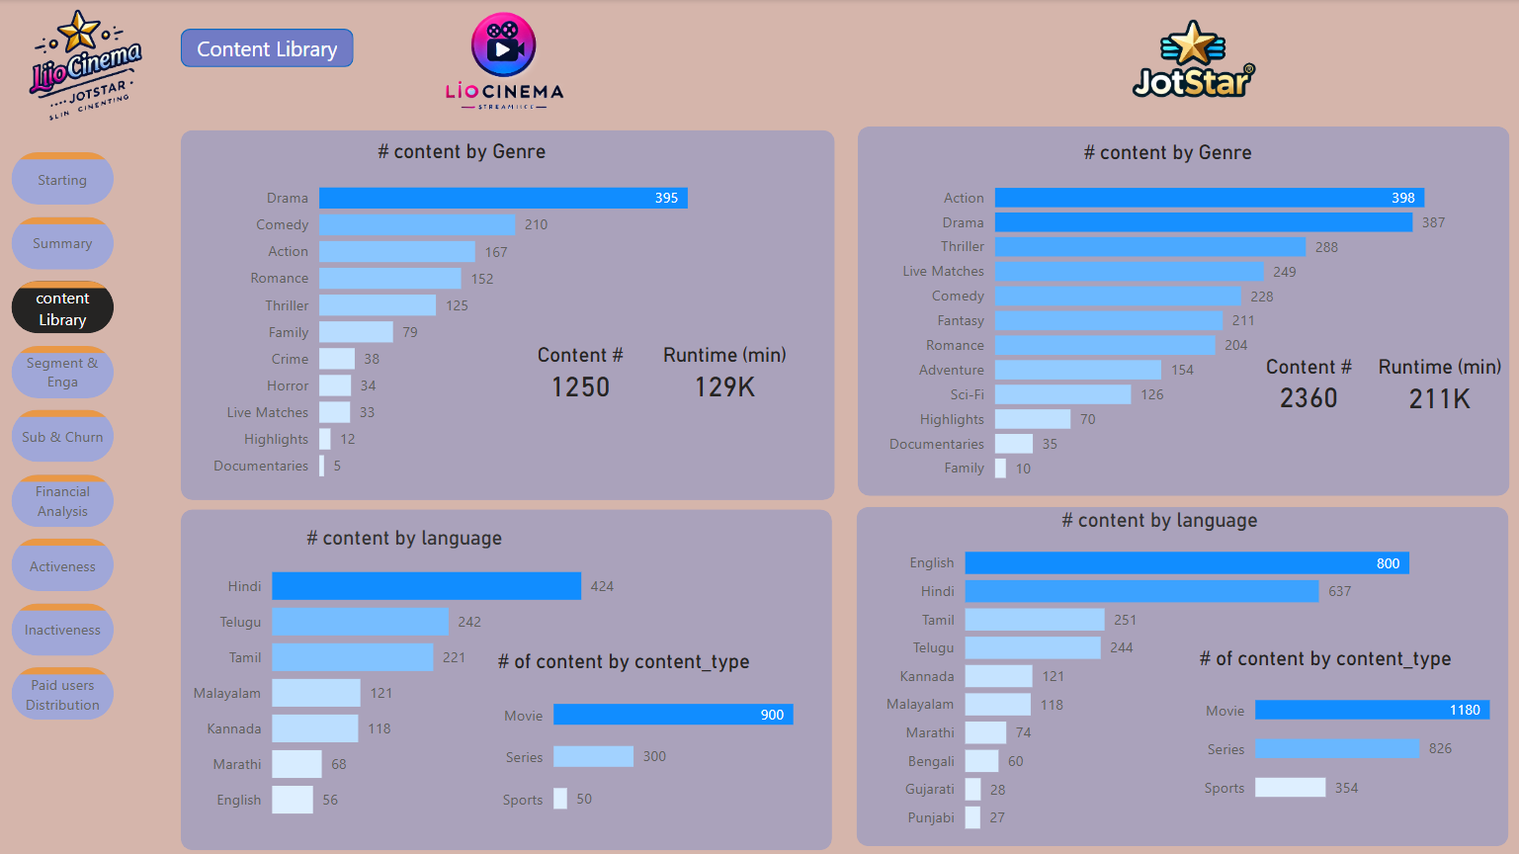

Slide 45
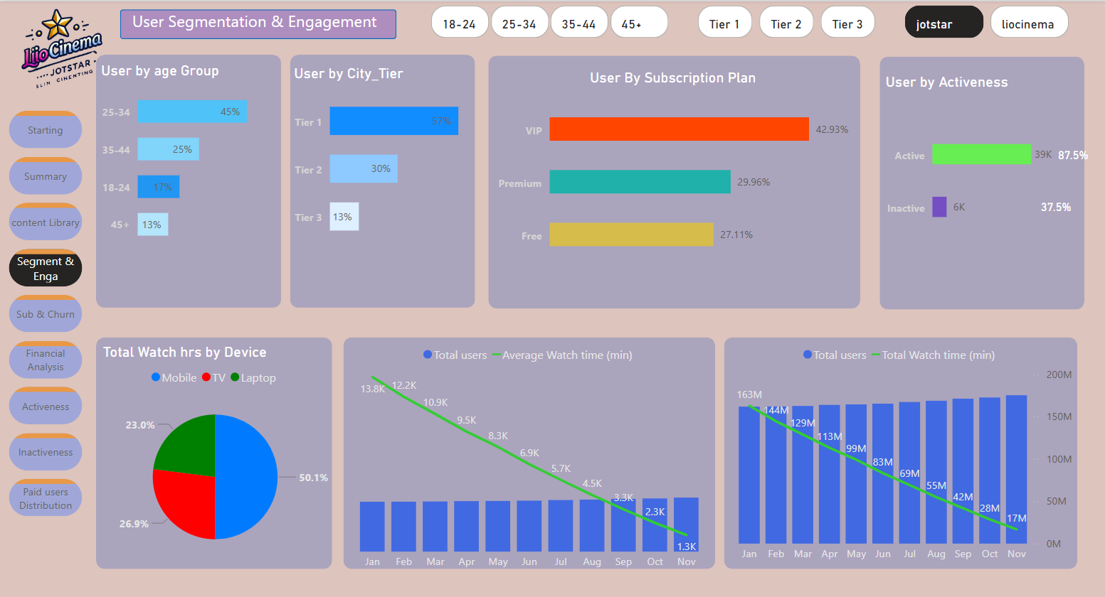

Slide 46
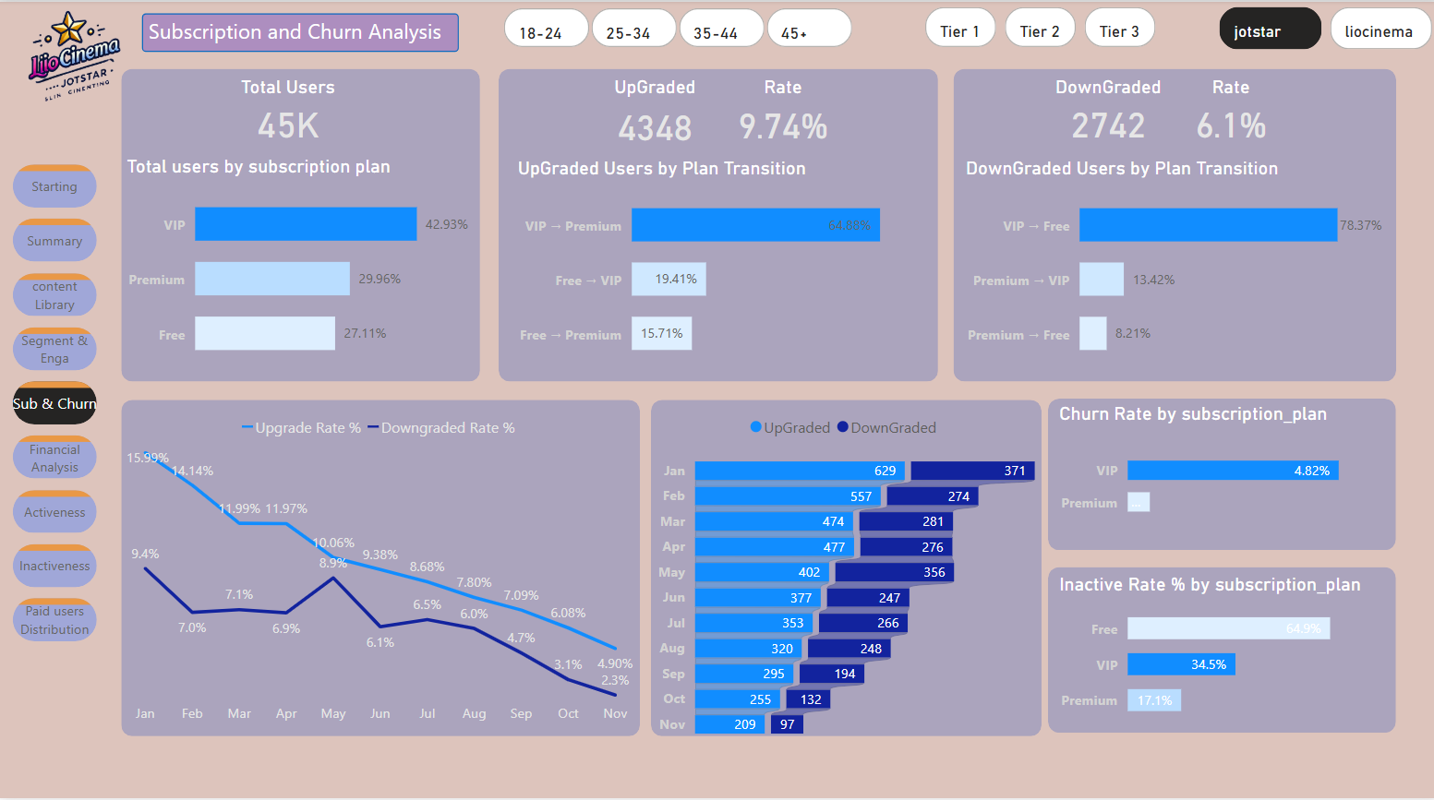

Slide 47
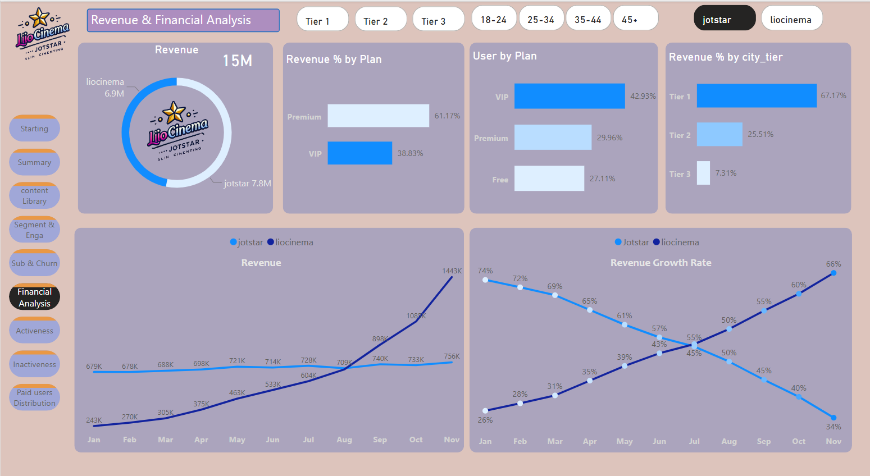

Slide 48
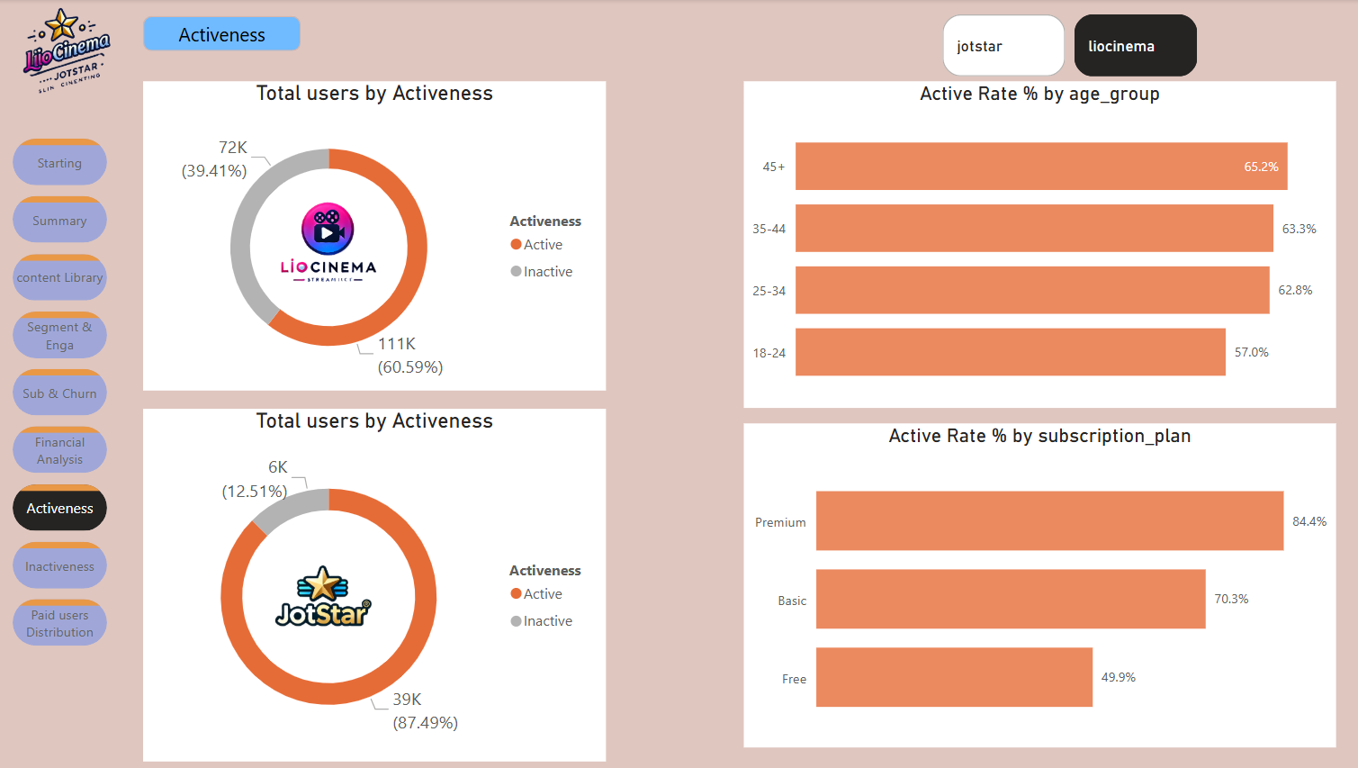

Slide 49


Slide 50


Slide 51
Dashboard
Download Presentation

